Slide 1

بِسْمِ اللّٰهِ الرَّحْمٰنِ الرَّحِيْمِ

Slide 2
Animations

Slide 3
Mobile Computing
Mobile Computing
LECTURE 09
Animations
Instructor:
Maulana Haq Nawaz

Slide 4
تصحیح نیت
حضرت محمد صلی اللہ علیہ وسلم نے فرمایا
اِنَّمَا الْاَعْمَالُ بِالنِّـیَّاتِ
ترجمہ
اعمال کا دارومدار نیتوں پر ہے

Slide 5

Little Efforts Daily Will Make You the Greatest
To systematically learn and get excellence in any concept / subject
روز کا کام روز کریں
اک مہینے کا کھانا ایک دن میں نہیں کھایا جا سکتا، ایسے ہی ایک مہینے کا کام ایک دن میں نہیں ہو سکتا

Slide 6
Little Efforts Daily Will Make You the Greatest
Importance of completing tasks on daily basis
Main Reason of Failure in Life
یہ کام کل کریں گے
جو کام کبھی بھی ہو سکتا ہے وہ کبھی نہیں ہوتا
زندگی ایک دن ہے اور وہ ہے آج۔ زندگی میں کل نام کی کوئی چیز نہیں ہے
جو دن آپ کی زندگی سے چلا گیا اب واپس نہیں آئے گا
آج کا کام آج ہی ہوسکتا ہے
جو گز گیا وہ آنا نہیں ، آنے والے دن کا پتہ نہیں ، آج میدان جما ہے تو اپنے جوہر دکھاؤ

Slide 7
How to Achieve BIG Goals in Life
Balanced Life is Ideal Life 😊
To achieve BIG Goals in Life
Make a Schedule of 24 Hours with a focus on Five main components of Human Life
Health
Physical Health
Mental Health
Social Health
Spirituality
Work
Family
Friends

Slide 8



جو کام کریں دل سے کریں
کام کرنا.
خوشی خوشی کام کرنا.
الله کو ساتھ لے کرخوشی خوشی کام کرنا.
آیت: إِيَّاكَ نَعْبُدُ وإِيَّاكَ نَسْتَعِينُ
ترجمہ: یا الله ہم تیری ہی عبادت کرتے ہیں.
اور تجھ ہی سے مد د مانگتے ہیں

Slide 9
Lecture Outline
1
Revision
2
Images
3
Animations
4
Movement, Rotation, Fade
5
Videos
6
Audios
7
Stop Complaining! Stop Criticizing! Let’s Start Contributing
8
Lecture Summary

Slide 10
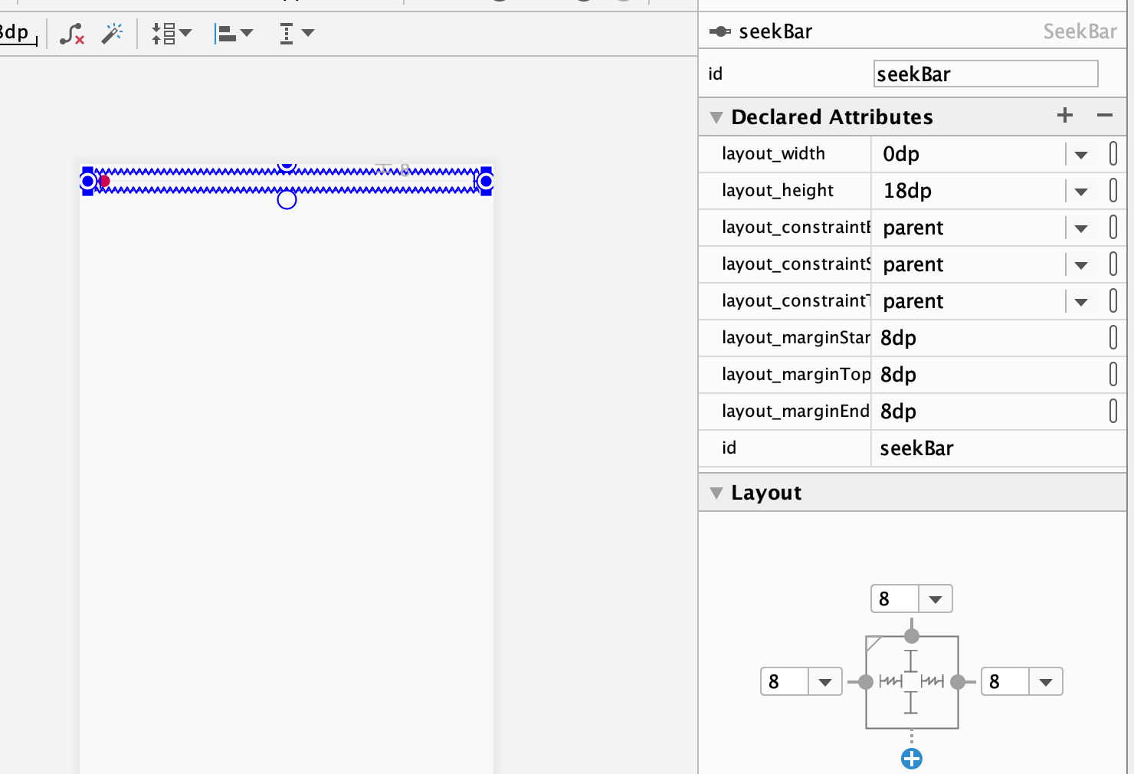
Add SeekBar
Notes:
Toasts are not clickable. If user response to a status message is required, consider instead using a Notification.

Slide 11
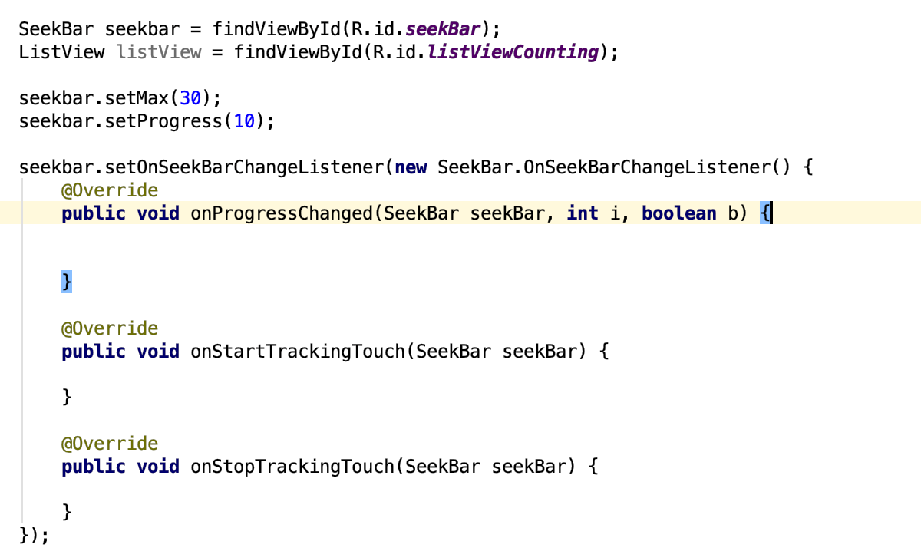
Code for SeekBar
Notes:
Toasts are not clickable. If user response to a status message is required, consider instead using a Notification.

Slide 12
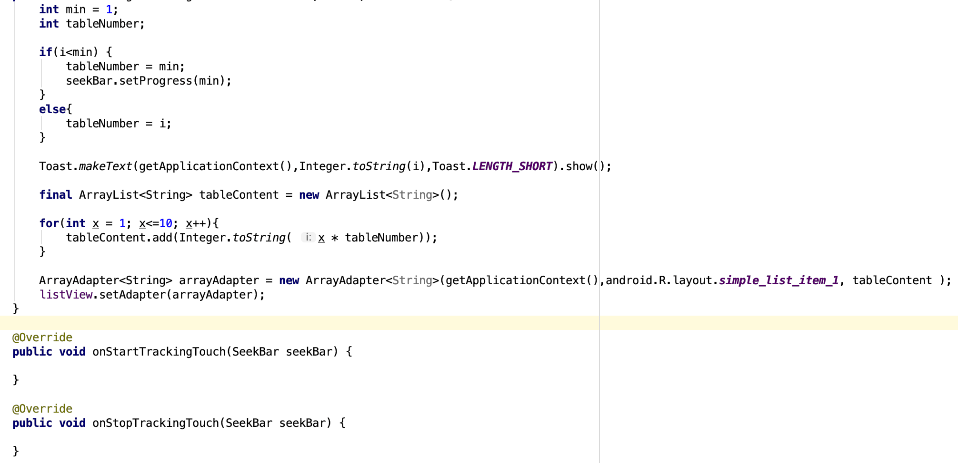
Code for SeekBar
Notes:
Toasts are not clickable. If user response to a status message is required, consider instead using a Notification.

Slide 13
Animation
Animations can add visual cues that notify users about what's going on in your app. They are especially useful when the UI changes state, such as when new content loads or new actions become available. Animations also add a polished look to your app, which gives it a higher quality look and feel.

Slide 14
Animation
To move, reveal, or hide views within the current layout, you can use the property animation system provided by the android.animation package, available in Android 3.0 (API level 11) and higher. These APIs update the properties of your View objects over a period of time, continuously redrawing the view as the properties change. For example, when you change the position properties, the view moves across the screen, or when you change the alpha property, the view fades in or out.

Slide 15
Animation
The property animation system is a robust framework that allows you to animate almost anything. You can define an animation to change any object property over time, regardless of whether it draws to the screen or not. A property animation changes a property's (a field in an object) value over a specified length of time. To animate something, you specify the object property that you want to animate, such as an object's position on the screen, how long you want to animate it for, and what values you want to animate between

Slide 16
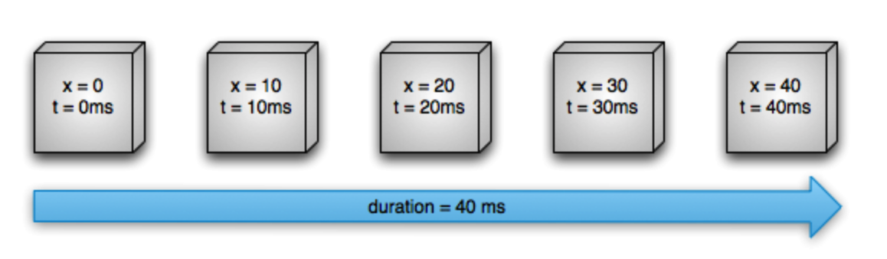
Linear animation
First, let's go over how an animation works with a simple example. Figure 1 depicts a hypothetical object that is animated with its x property, which represents its horizontal location on a screen. The duration of the animation is set to 40 ms and the distance to travel is 40 pixels. Every 10 ms, which is the default frame refresh rate, the object moves horizontally by 10 pixels. At the end of 40ms, the animation stops, and the object ends at horizontal position 40. This is an example of an animation with linear interpolation, meaning the object moves at a constant speed.

Slide 17
Non-linear animation
You can also specify animations to have a non-linear interpolation. Figure illustrates a hypothetical object that accelerates at the beginning of the animation, and decelerates at the end of the animation. The object still moves 40 pixels in 40 ms, but non-linearly. In the beginning, this animation accelerates up to the halfway point then decelerates from the halfway point until the end of the animation. As Figure shows, the distance traveled at the beginning and end of the animation is less than in the middle.

Slide 18



Zoom

Slide 19
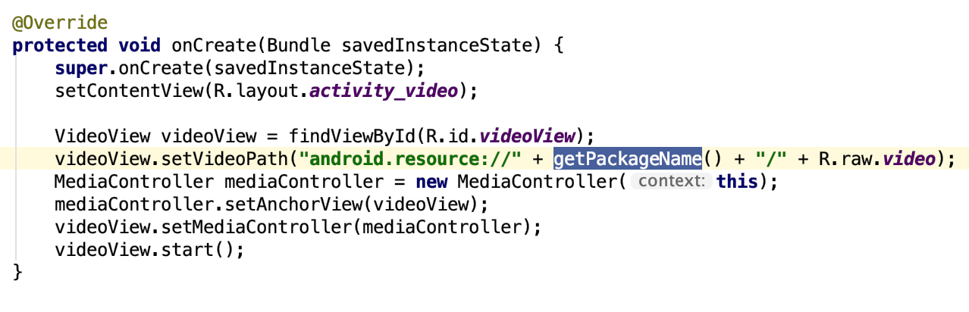
Video

Slide 20
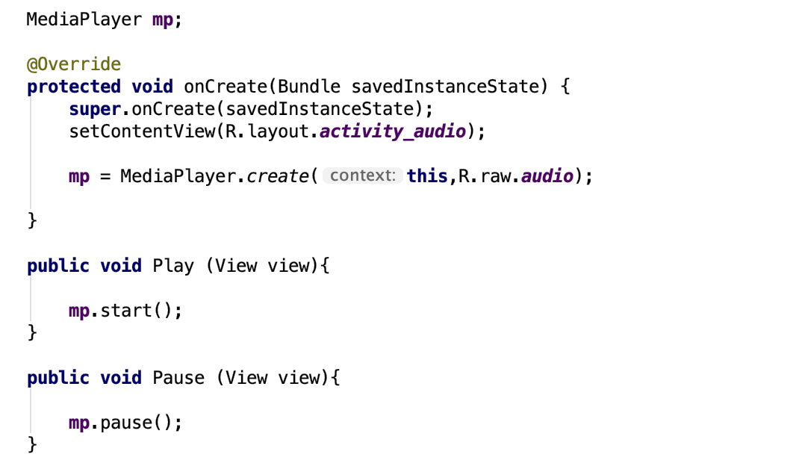
Audio

